Slide 1


Mastering OKRs key towards self-directed learning & self management
Soft skills
IT skills
Project skills
Mastering OKRs

Slide 2
Content
OKRs introduction
Applying OKRs — structure & practice
Peer-tutoring on OKRs
Mastering OKRs

Slide 3
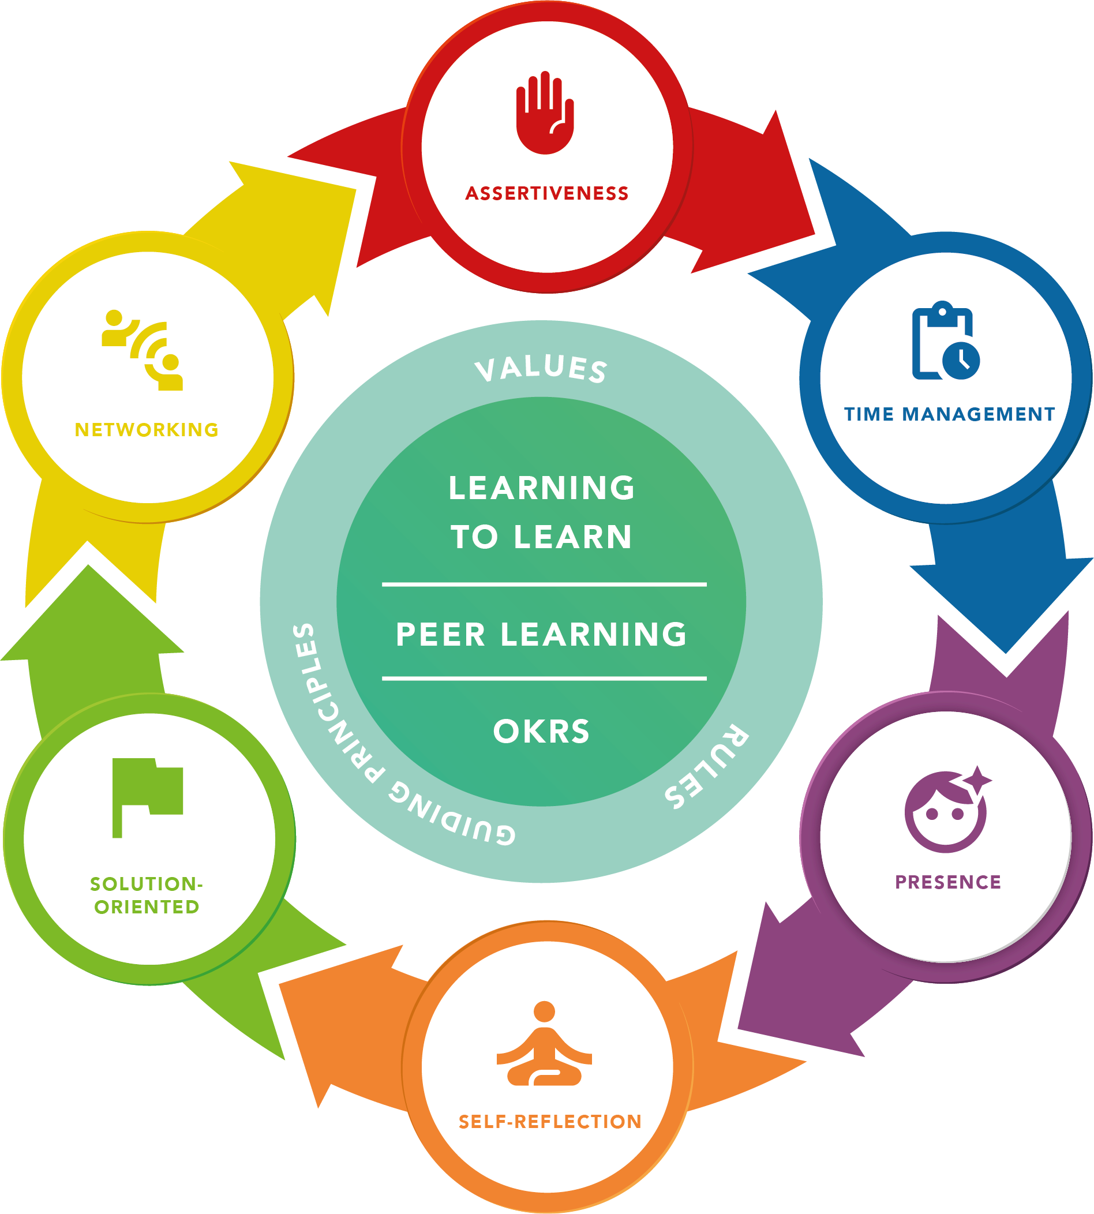
Mastering OKRs

Slide 4

A schedule for Self-directed & Peer Learning. All project-based.
curriculum = culture (values & rules) + content (assignments/projects) + L2L/PL + Market Feedback + Practice
Weekly learning plan
Including IT + Soft Skills
Lead
8.45 - 09:00
Joining class
Students
09:00 - 9.15
Check-in
Learning Coach
9.15 - 9.30
Scrum
(Table)Peers
9.30 - 12:00
Self directed & Peer learning
Students
13:00 - 14:00
Q&A/review/talk
Learning Coach
14:00 - 16:30
Self directed & Peer learning
Students
16:30-17:00
Day closing
Students
Weekly Final Project Assignment

Slide 5
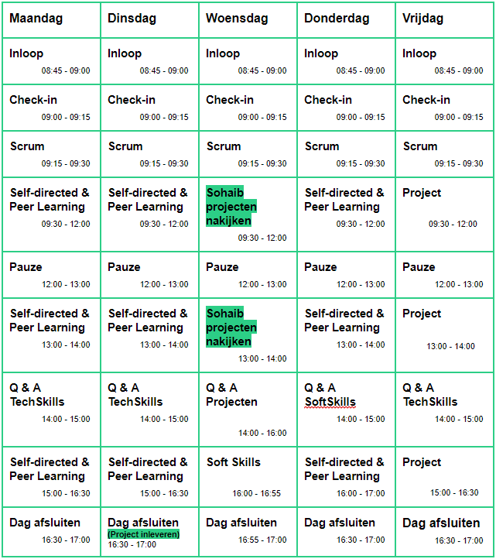
A schedule for Self-directed & Peer Learning. All project-based.
Joining class: always be on time (as in a professional setting)
Check-in: the learning coach is kicking off the day
Scrum: stand-up with your learning table or Peer-group
Self-directed & Peer learning: learning by doing assignments from (‘Weekly Learning plan’)
Q&A Tech/Soft Skills: Deep dives with Learning coach
Day closing: Wrapping up the day

Slide 6
The role of Peers & learning coaches during Self-directed & Peer Learning.
When you need direction during assignments & learning:
1st line support: (Table) Peers
2nd line support: Slack + Cohort Peers
3rd line support: Learning Coach (who is providing directions, no direct answers)
Q&A Tech/Soft Skills: Deep dives with Learning coach + Peers about Qs & fundamentals (Slack forms the basis)
Project reviews: The Learning coach will review the projects (on Wednesdays) and provide feedback (both personally & group-based.) Sohaib is the leading learning coach in project reviews
The role of Peers:
Peers help formulate the questions
Peers are providing direction, no direct answers
Peers listen to explanation when other Peer explains the solution/approach
Peers share plenary insights (table/cohort)
Leading Peers are invited to become Jr. Learning Coach during the cohort, after 4 weeks (improving their IT/soft skills + improving IT skills of cohort Peers)

Slide 7
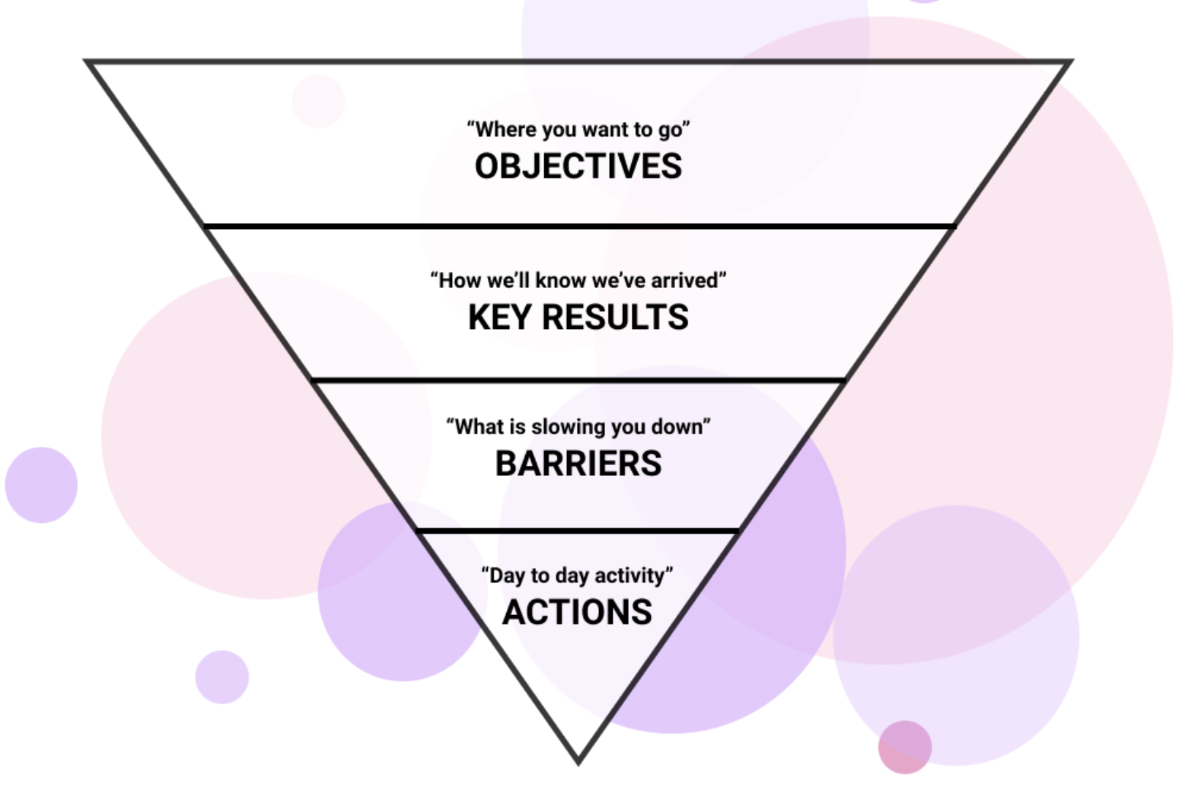
Introducing Objectives & Key Results
Introduction — the context
!
Watch this video about OKRs >
Read this article about OKRs >
From: Moving to OKRs in 30 days: A step by step guide
Mastering OKRs

Slide 8
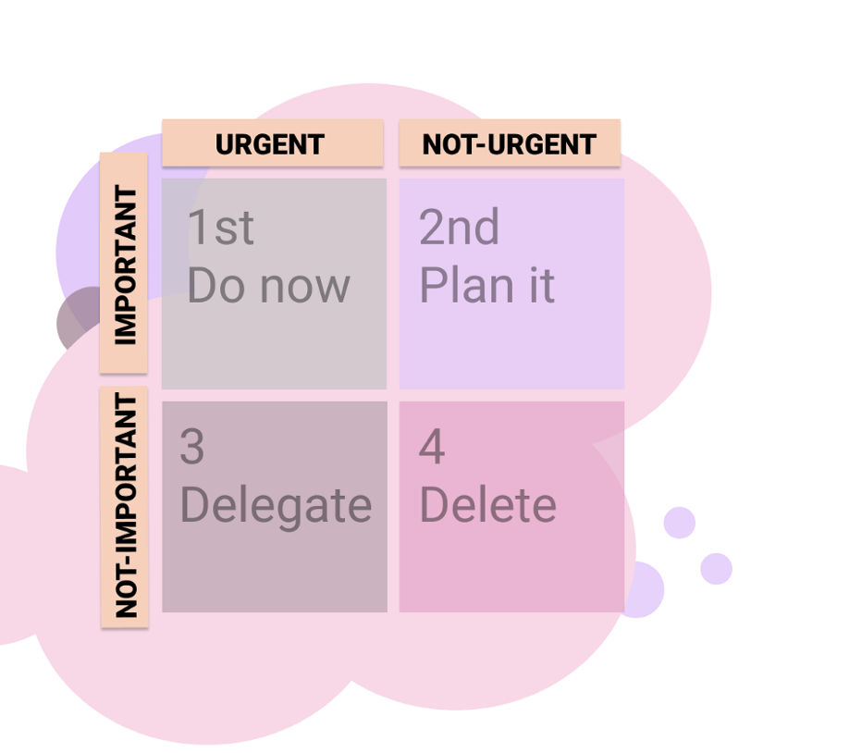
Introducing Objectives & Key Results
Introduction — the context
!
Watch this video about OKRs >
Read this article about OKRs >
OKRs is all about: Priorities
Assignment:
What is your #1 priority on personal level?
What is your #1 priority on professional level?
Write it down on a yellow pager
Write it down on a yellow pager
Whatever objective you have, it should be both important and urgent.
come up with as many as you can. These won’t be the real objectives, so don’t worry too much about the ideas.
Personal
Professional
Mastering OKRs

Slide 9
Personal OKR
Professional OKR
Earn two Certificates AWS
Learn how to learn (self directed)
Learn how to stay friendly while driving
Become a vegetarian
Read 5 books (and avoid Netflix)
Become a great Peer Tutor
Find a new place to live
Meet new friends
Read 5 books (and avoid Netflix)
Find two new employer partners for TechGrounds
100% professional writing skills
Stop smoking
(have a healthy lifestyle)
“Make it all about your Identity”
Mastering OKRs

Slide 10

The role of the learning coach: S/he is helping you to do it yourselves.
Classroom OKRs
Objectives & Key Results
Maintaining values & rules of engagement in the classroom
Building & providing the IT curriculum
Facilitate in self-directed learning
Facilitating in gaining IT skills
Reinforcing Peer-Learning
Support in employability
Empowering soft skills
Empowering project skills
Creating a Peer & Self-directed Learning group/(team)
90+% certificates score
100% of learners are Employable
Have people up-skilling themselves via L2L
Mastering OKRs

Slide 11
How all our OKRs are interrelated
TechGrounds company OKRs
OKRs
1/ Creating a Peer & Self-directed Learning group/(team)
2/ 90+% certificates score
3/ 100% of learners are Employable
4/ Have people up-skilling themselves via L2L
5/ Cohort specific OKR, by the students
Classroom OKRs
Learning Coach OKRs
Student OKRs
OKRs
1/ master OKRs
2/ implement the Soft Skills
3/ finalise 2.0 version of AWS
3/ up-skill in XYZ
Your OKRs
1/ personal: […]
2/ professional: […]
Mastering OKRs

Slide 12
How all our OKRs are interrelated
TechGrounds company OKRs
OKRs
1/ Creating a Peer & Self-directed Learning group/(team)
2/ 90+% certificates score
3/ 100% of learners are Employable
4/ Have people up-skilling themselves via L2L
5/ Cohort specific OKR, by the students
Classroom OKRs
Learning Coach OKRs
Student OKRs
OKRs
1/ master OKRs
2/ implement the Soft Skills
3/ finalise 2.0 version of AWS
3/ up-skill in XYZ
Your responsibility
Your responsibility
Mastering OKRs

Slide 13
How all our OKRs are interrelated
TechGrounds company OKRs
OKRs
1/ Creating a Peer & Self-directed Learning group/(team)
2/ 90+% certificates score
3/ 100% of learners are Employable
4/ Have people up-skilling themselves via L2L
5/ Cohort specific OKR, by the students
Classroom OKRs
Learning Coach OKRs
Student OKRs
Your responsibility
Your responsibility
Mastering OKRs

Slide 14
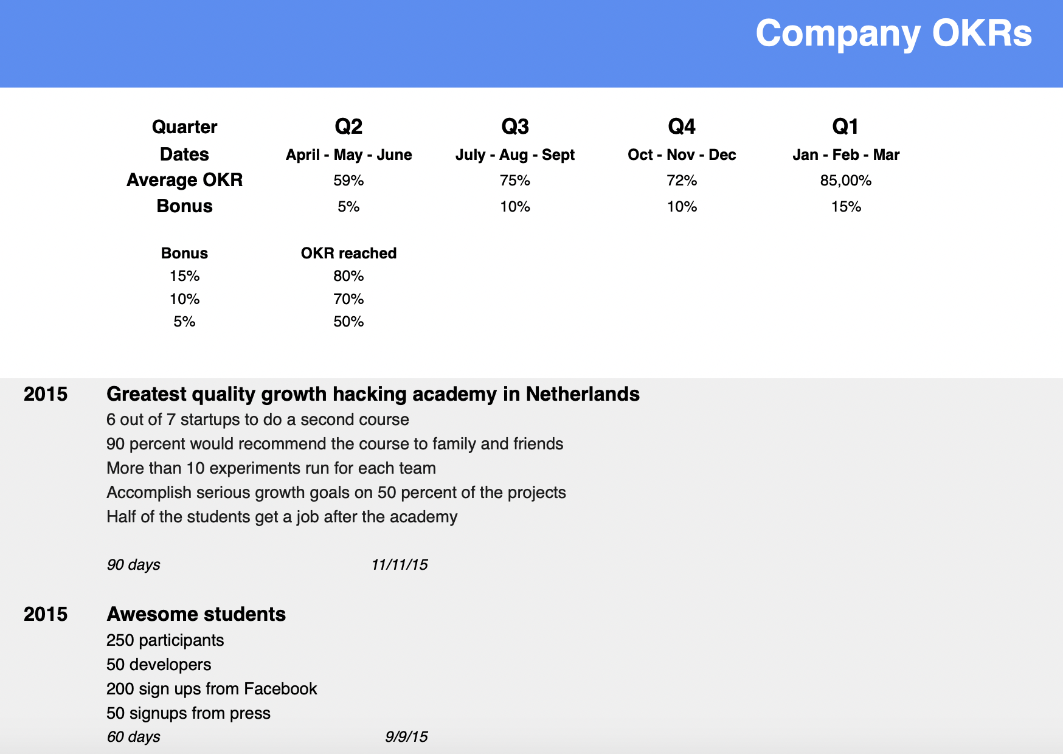
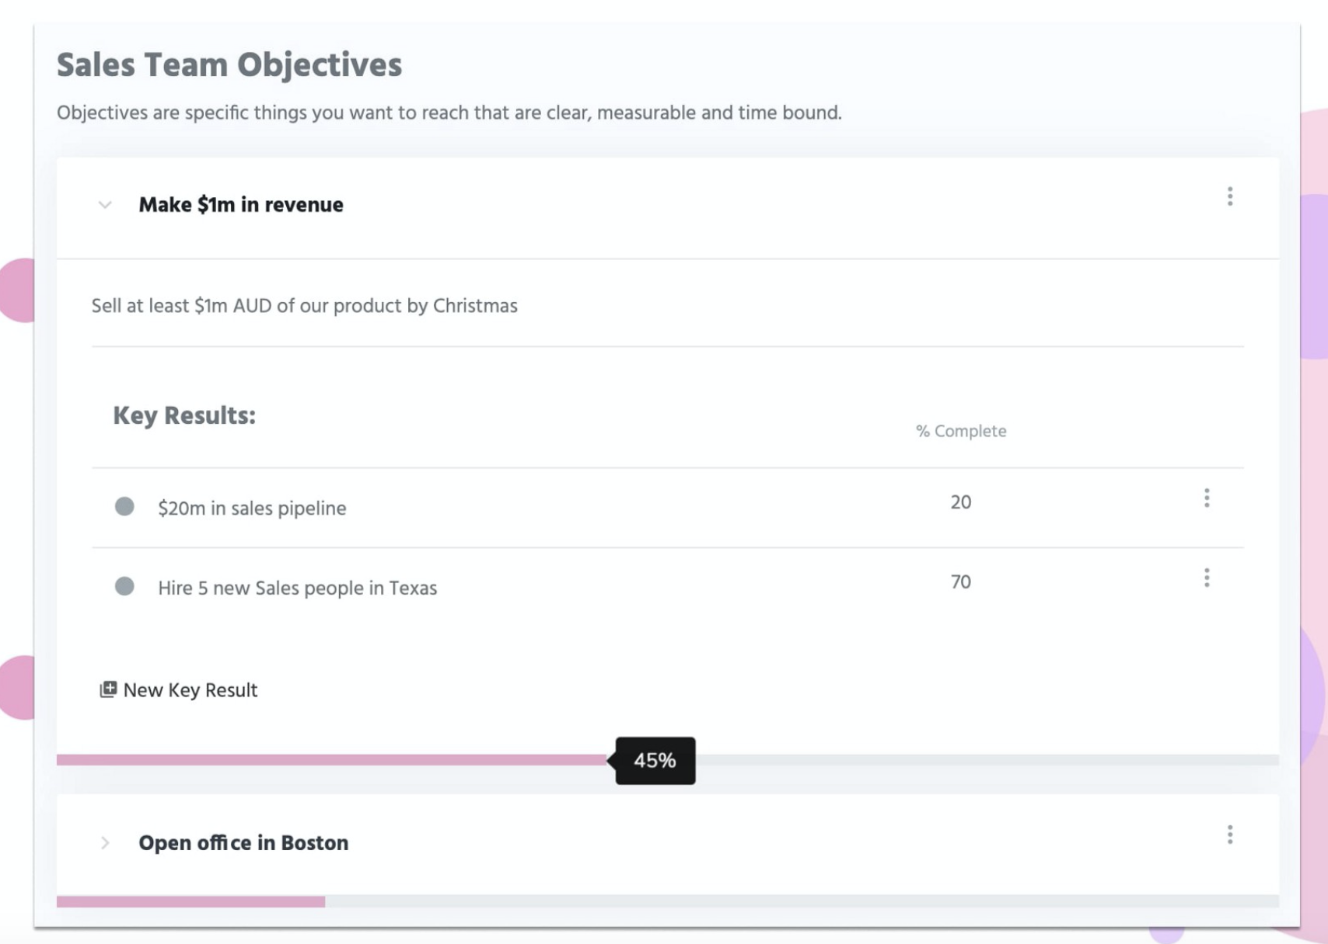
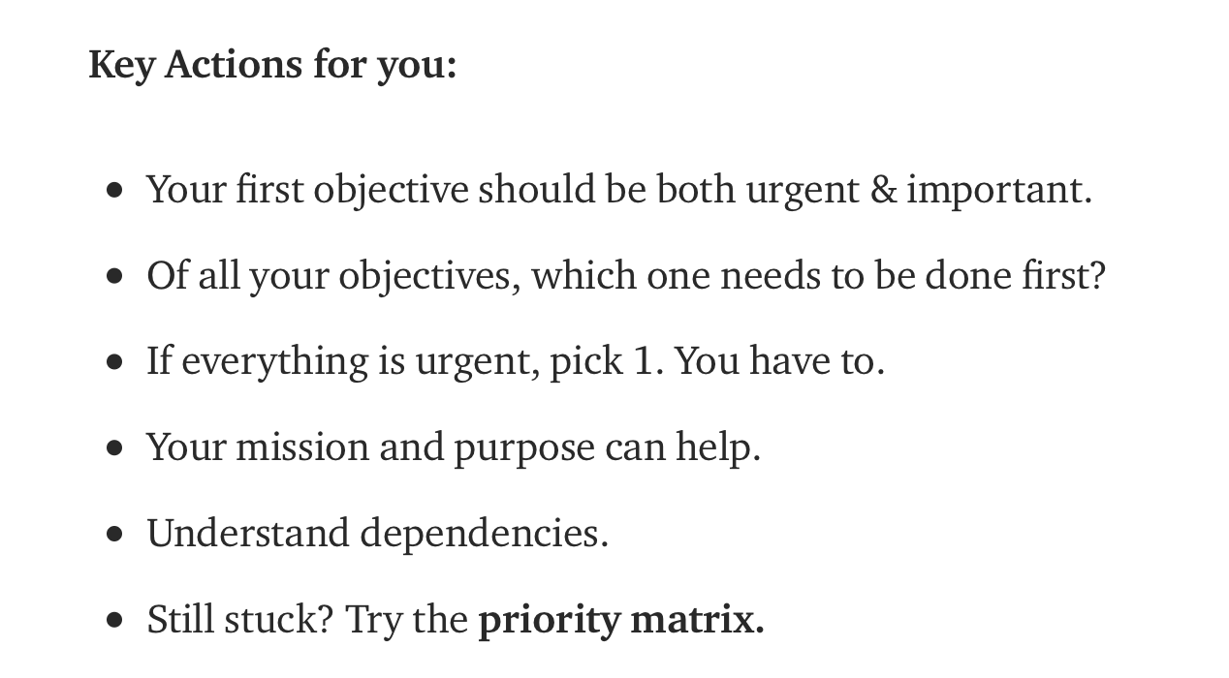
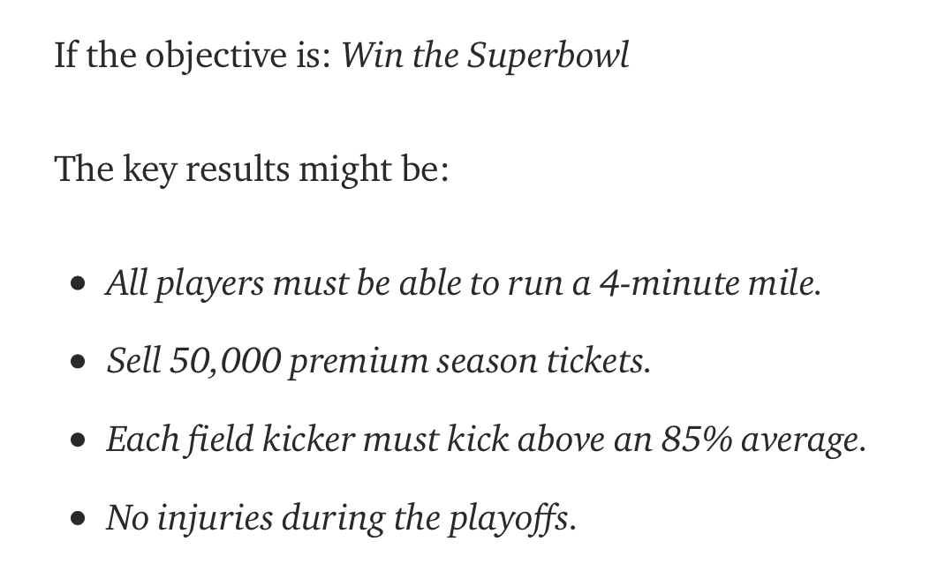
Guidance!
Mastering OKRs

Slide 15
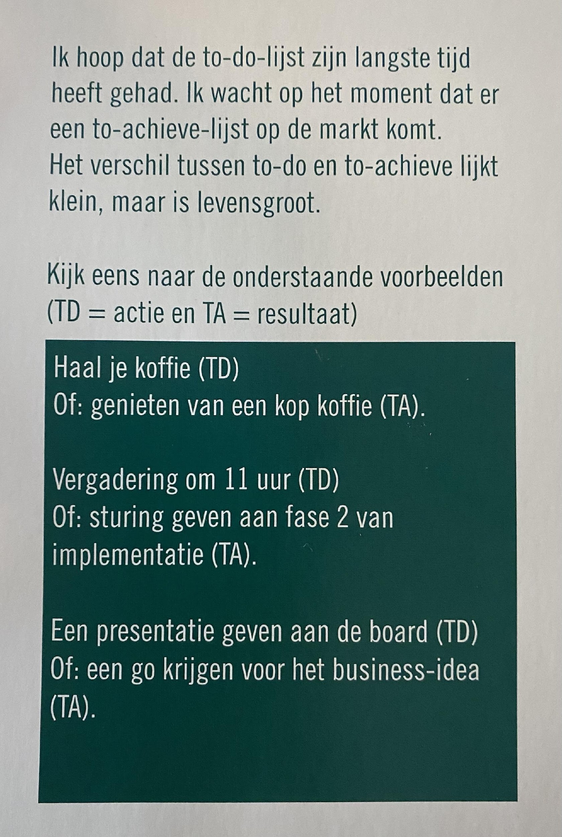
Talk about outcomes vs outputs
One of the biggest blunders teams make is to focus on outputs (doing ….you know, things) vs outcomes (results you want to see).
To-do vs To-achieve
Key results mean numbers
Marissa Mayer from Google / Yahoo is famous for saying that it’s not a key result unless it has a number in it. If you only remember 1 thing about key results, this is it. Make sure you can actually measure the key results at the end of the cycle.
having a key result like “Make more money” is great, but what makes it better is saying “Make $1.2 USD selling Monitors by June 13th”.
This is important because when you set an outcome (like all players must be able to run a 4-minute mile) you are leaving the how up to the team. You are not saying (to leave autonomy in the team): Train 5 times a week; Do 10 leg presses and 20 minutes on cardio; Or practice running between 5 pm and 6 pm on Fridays.
Uit: Slappe Thee is geen Thee, Ruben Nieuwenhuis

Slide 16
Personal OKR
Professional OKR
& Key Results
Learn how to stay friendly while driving
Key results
1/ Smile at least 10 times to another car driver during each drive
2/ be 100% friendly when something happens and the other is actually responsible
3/ always prepare yourself in being 100% relaxed before you start driving
Read 5 books (and avoid Netflix)
Key results
1/ sign up for 2 audio book platforms
2/ listen/read every morning and evening at least 2 pages (or listen to 2 pages)
3/ avoid watching Netflix at 3 days a week
Key results
1/ first month only 3 meat-meals (MM) a month, 2nd month only 2 MM, 3rd months no MMs
2/ educate yourself in preparing 7 vegetarian dishes that are delicious
3/ read 2 books about the benefits of being vegetarian
4/ tell 10 friends & family about you being vegetarian
Become a vegetarian
Find two new employer partners for TechGrounds
Key results
1/ sent 25 potential employer partners an email
2/ have the sales material 100% updated & professional
3/ run 3 experiments to trigger new employer partners
Mastering OKRs

Slide 17
The first time you set OKRs you’ll make mistakes. Make peace with that. You’ll set the wrong goals, you’ll set the wrong key results, the wrong cadence, you won’t check-in enough with the team and generally speaking it will take a few weeks before anyone knows what you’re talking about. But relax, you need to just cut your teeth on them, and I promise you, the second cycle, performance will go through the roof.
!
Study this website about OKRs >
Also tools available via this website
Mastering OKRs

Slide 18
Metrics that Matter (MTM)
Every company should have what is known as its MTM or Metric that matters. It’s important to have just one, and it should be your north star. It’s the one number you want everyone to obsess about.
When setting OKRs your MTM could be an objective or a key result. But what’s important is that for your first time setting OKRs you 100% want to make sure the MTM is included. For us, our MTM was weekly responded surveys. This is the biggest test of engagement in the platform and we track it (and do our best to manipulate it) each week.
Examples of common MTM’s are things like NPS, Monthly Recurring Revenue, Gross Profit, Monthly Unique Website views or even, total pizzas sold.
Your MTM should ideally be a leading indicator.
Read these 16 metrics that matter for startups >
Mastering OKRs

Slide 19
Content
OKRs introduction
Applying OKRs — structure & practice
Peer-tutoring on OKRs
Mastering OKRs

Slide 20
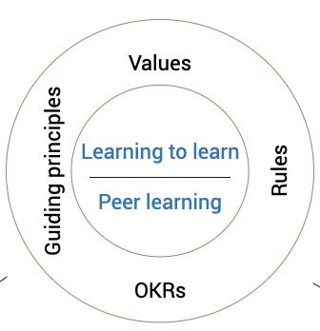
Applying OKRs
Overall Structure & Practice
Values
Rules
Guiding Principles
OKRs
Define your OKR’s for a 3 month cycle
Differentiate in 3 objectives: 1/ Professional, 2/ Personal, 3/ Learning
Work via your personal OKR portfolio framework
Have a weekly personal & Peer introspective
Discuss Monthly the classroom OKR’s (the learning coach is responsible)
Present & evaluate the OKRs after 1 month with Peers and during Leadership Q&A.
Define your OKR’s for the new 3 month cycle
Mastering OKRs

Slide 21
The first steps
Pick your main objectives and share it with a Peer-student
Don’t set key results too far above normal for your first cycle.
Know what your MTM is and include it as one key result.
When comparing your goals to the cohort-peers, make sure you’re in a similar circumstance (Apples vs Oranges)
Define what success looks like. Do you want 100% key results or 60% — 70%?
Make sure you work according OKRs beginning week 3 of the study. The first two weeks are needed to study OKRs and play around with them. In week 3 it is for real.
Mastering OKRs

Slide 22
Content
OKRs introduction
Applying OKRs — structure & practice
Peer-tutoring on OKRs
Mastering OKRs

Slide 23
How to be an OKR-Peer for your colleague cohort students?
Lets brainstorm!

